Slide 1
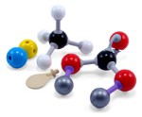
Jmol Model Kit Mode
A Revolutionary Molecular Visualization Tool
for
Communicating and Teaching Chemistry

Slide 2
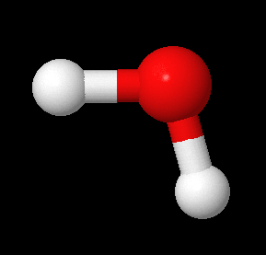
Molecular Viewers & Some Terminology
3D
Coordinate
File
Viewer
Example Coordinate/Data Formats
MDL Molfile
mol
Protein Data Bank
pdb
SPARTAN
spartan
JME Editor
jme
Structure Data Format
sdf

Slide 3
Molecular Viewers & Some Terminology
3D
Coordinate
File
Viewer
Example Coordinate/Data Formats
MDL Molfile
mol
Protein Data Bank
pdb
SPARTAN
spartan
JME Editor
jme
Structure Data Format
sdf
**H2O**
**Created by Jmol for Current Model**
3 2 0 0 0 0 1 V2000
-0.26657 -0.05812 0.01167 H 0 0 0 0 0 0
0.72186 -0.03307 -0.04718 O 0 0 0 0 0 0
0.98988 -0.98189 -0.14101 H 0 0 0 0 0 0
1 2 1 0 0 0
3 2 1 0 0 0
M END
Atoms & Bonds
XYZ Data
Connection Data

Slide 4
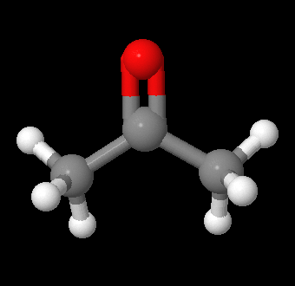
Molecular Viewers & Some Terminology
3D
Coordinate
File
Viewer
Example Coordinate/Data Formats
MDL Molfile
mol
Protein Data Bank
pdb
SPARTAN
spartan
JME Editor
jme
Structure Data Format
sdf
Example Connectivity Formats
SMILES
InChi
C(C)(C)=O
1S/C3H6O/c1-3(2)4/h1-2H3

Slide 5
Molecular Viewers & Some Terminology
3D
Coordinate
File
Viewer
Example Coordinate/Data Formats
MDL Molfile
mol
Protein Data Bank
pdb
SPARTAN
spartan
JME Editor
jme
Structure Data Format
sdf
Example Connectivity Formats
SMILES
InChi
C(C)(C)=O
1S/C3H6O/c1-3(2)4/h1-2H3
Example Identifiers
Name
InChiKey
Acetone
CSCPPACGZOOCGX-UHFFFAOYSA-N

Slide 6
Jmol Viewer: Extended Display Capability
3D
Coordinate
File
Jmol
Example Coordinate/Data Formats
MDL Molfile
mol
Protein Data Bank
pdb
SPARTAN
spartan
JME Editor
jme
Structure Data Format
sdf

Slide 7
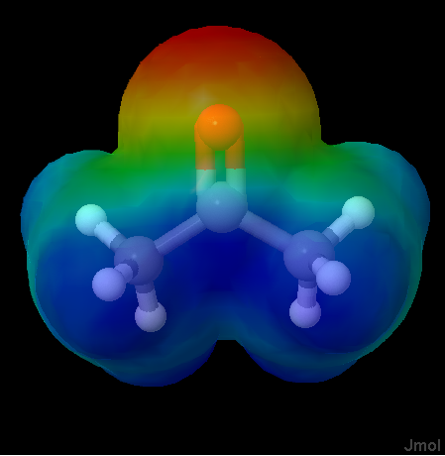
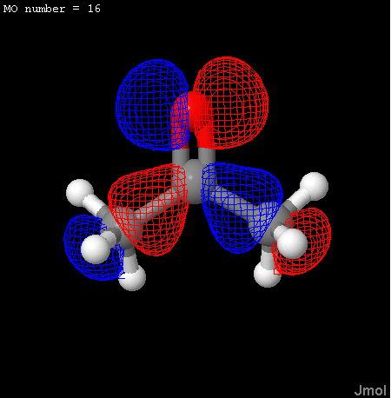
Jmol Viewer: Extended Display Capability
3D
Coordinate
File
Jmol
Example Coordinate/Data Formats
MDL Molfile
mol
Protein Data Bank
pdb
SPARTAN
spartan
JME Editor
jme
Structure Data Format
sdf
MEP Calculated from sdf Data
HOMO Calculated from spartan Data

Slide 8
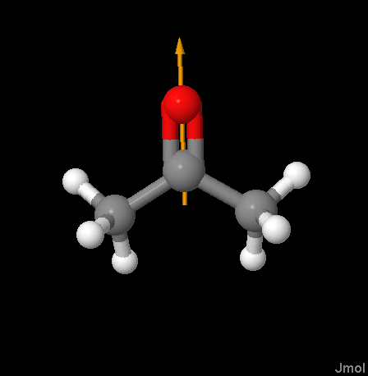
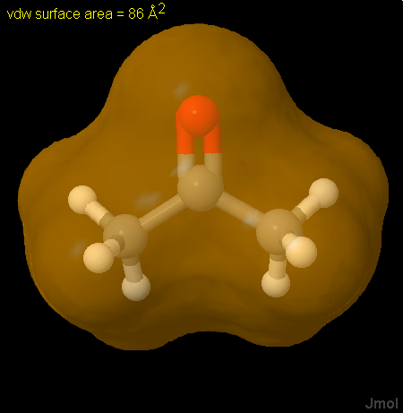
Jmol Viewer: Calculation Capability
Jmol Calculated Dipole
Jmol Calculated van der Waals

Slide 9
Jmol Viewer: Calculation Capability
Jmol Calculated Dipole
Jmol Calculated van der Waals
Jmol has many other calculation capabilities.

Slide 10
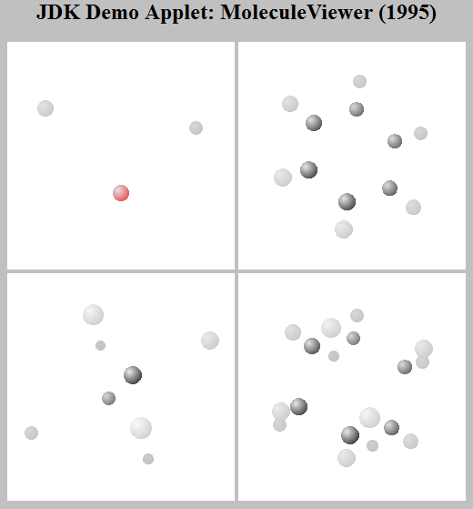
Jmol: Brief Prehistory
1990 – Minnesota Supercomputer Center introduces Xmol
1993 – Roger Sayle releases the code for the stand alone application RasMol
1995 – Sun Microsystems’ JDK includes the demo applet: Molecule Viewer
1996 – The MDL Information Systems’ Chime plug in makes its Web debut
http://chemagic.com/code/molecule_viewer.htm

Slide 11
Jmol: 1998 - 2001
Dan Gezelter (Department of Chemistry, Notre Dame University ) developed the original version of Jmol in his spare time while working as a post-doc at Columbia University : 1998 - 2001.
Jmol was originally intended to be a replacement for XMol which was a molecular viewing program developed at the Minnesota Supercomputer Center. Although the program executables were distributed, the source code was not available to users, and since the program has not been maintained, the free binary versions have become obsolete.
Dan chose to avoid the same problems by making Jmol open source.
“Do not be concerned if you get a number of error messages when you run XMol. Xmol complains a lot but it runs fine.” – Xmol Web site

Slide 12
Jmol: 2001 - 2002
Bradley A. Smith took over the project and did a lot of work in streamlining the project as well as the software. Under his leadership many new features were added, some of which contributed by users.
By the end of 2002, Egon Willighagen became the new project leader and a start was made with integrating Jmol with The Chemical Development Kit, something that was already planned in September 2000 by Dan Gezelter, Egon Willighagen and Christoph Steinbeck (Group Leader, CDK).

Slide 13
Jmol: 2002 - 2006
In 2002, Miguel (Michael) Howard volunteered as the primary developer. He made many major enhancements including drastically improved performance, support for macromolecules, and implementation of the RasMol / Chime script command language. Howard's work culminated in the release of an open-source replacement for Chime in 2006.
“I was working on a web page project and needed ‘on-the-fly’ models… Miguel wrote back telling me how it probably wouldn't work, then a few hours later pointed me to a new version of Jmol that worked like a charm.” – Bob Hanson, Current Jmol Primary Developer
Miguel (Michael) Howard is a professional computer programmer. He was between jobs and was looking for something to do while in Spain for an extended period. He now lives in Maine.

Slide 14

Jmol: 2002 - 2006
Robert M. Hanson (Department of Chemistry, St. Olaf College) became lead developer in 2006, and he has vastly enhanced Jmol's capabilities, with the year 2010 being an unbelievably productive. This presentation is about two aspects of this year of Jmol enhancement – The Jmol Model Kit Mode and External Database Connectivity.
Bob Hanson Web Site

Slide 15
Jmol Creative Community: 1998 - 2011
Throughout its history, the Jmol creative community, users and developers, have benefited from solid leadership. Bob Hanson’s tenure has been marked by three leadership strengths:
As a chemist he is a true eclecticist.
While he is not a professional programmer, he could be.
He is willing to entertain and implement almost any new idea.
The net result is that at any given time there is a wealth of ideas on the table for user/developer discussion. There is no turf to protect. Ideas of little value fall naturally by the wayside, and useful creative ideas flow naturally to the surface.

Slide 16
Jmol: The de facto Tool
If You’ve Seen a Web Molecular Model, You’ve Probably Seen Jmol
By 2006, Jmol had become the de facto molecular viewer of choice supporting education and research in chemistry/cheminformatics/molecular biology. Its powerful graphics and scripting language played a key role in this support.
Still...
In the hands of many users unfamiliar with application scripting, it came down to…

Slide 17
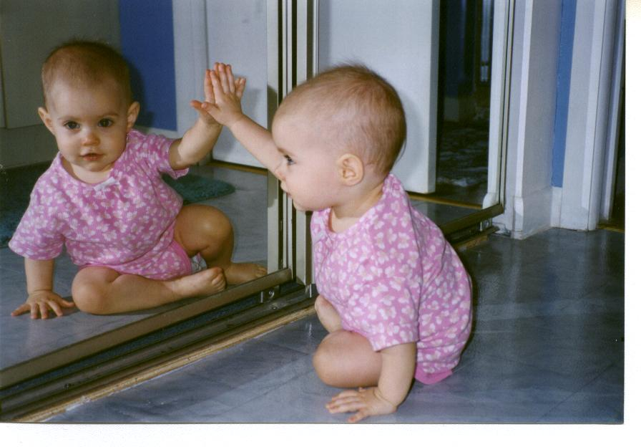
See the Pretty Molecule Spin
Chiral Babies
Craig and Emily Rothenberger

Slide 18
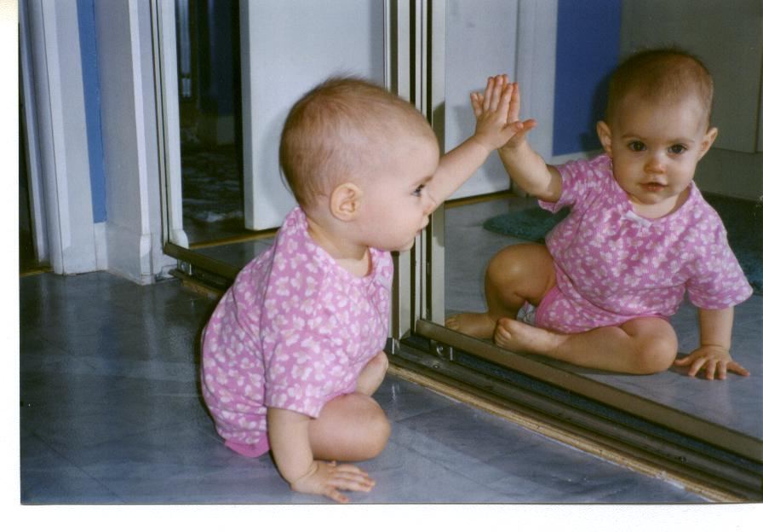
See the Pretty Molecule Spin
Chiral Babies
Craig and Emily Rothenberger

Slide 19
See the Pretty Molecule Spin
Chiral Babies
Craig and Emily Rothenberger

Slide 20
See the Pretty Molecule Spin
Chiral Babies
Craig and Emily Rothenberger

Slide 21
See the Pretty Molecule Spin
Chiral Babies
Craig and Emily Rothenberger

Slide 22
See the Pretty Molecule Spin
Chiral Babies
Craig and Emily Rothenberger

Slide 23
See the Pretty Molecule Spin
Chiral Babies
Craig and Emily Rothenberger

Slide 24
See the Pretty Molecule Spin
Chiral Babies
Craig and Emily Rothenberger

Slide 25
See the Pretty Molecule Spin
Chiral Babies
Craig and Emily Rothenberger
Which brings us to an important point…

Slide 26
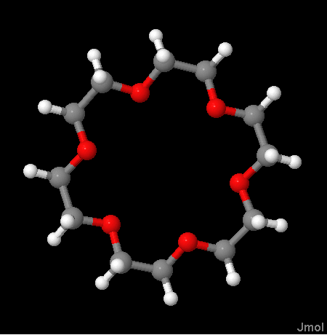
Jmol Can Do So Much More

Slide 27
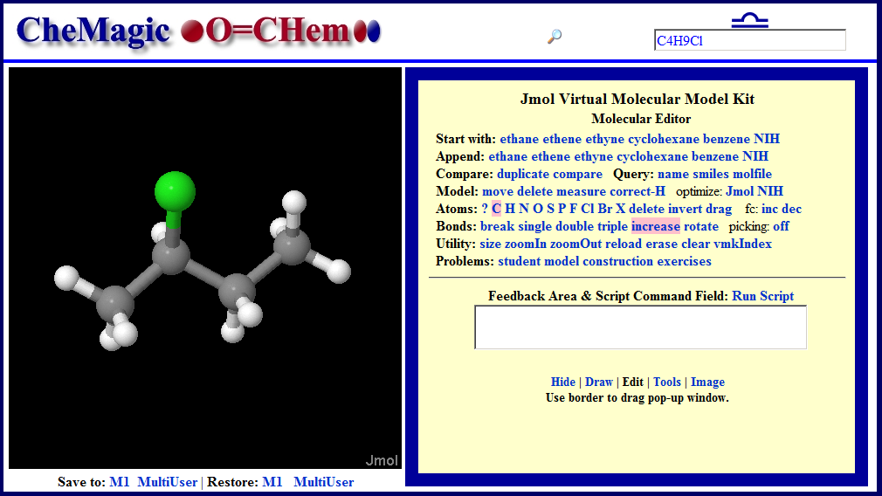
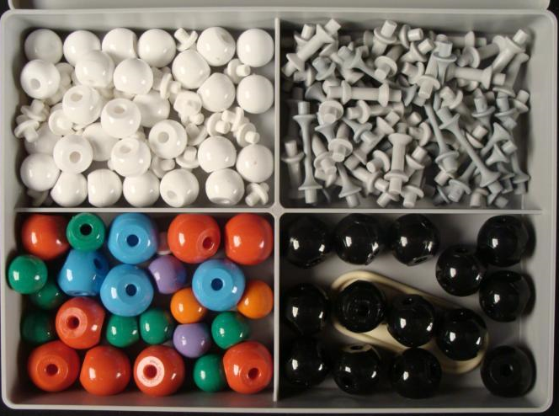
CheMagic O=Chem VMK
A Web Application Built on a Jmol Foundation
With apologies to Irving Berlin!
“Anything you can do. I can do better. I can do anything better than you.”
“No you can’t.”
“Yes I can.”
“No you can’t.”
“Yes, I can. Yes, I can. Yes, I can.”

Slide 28
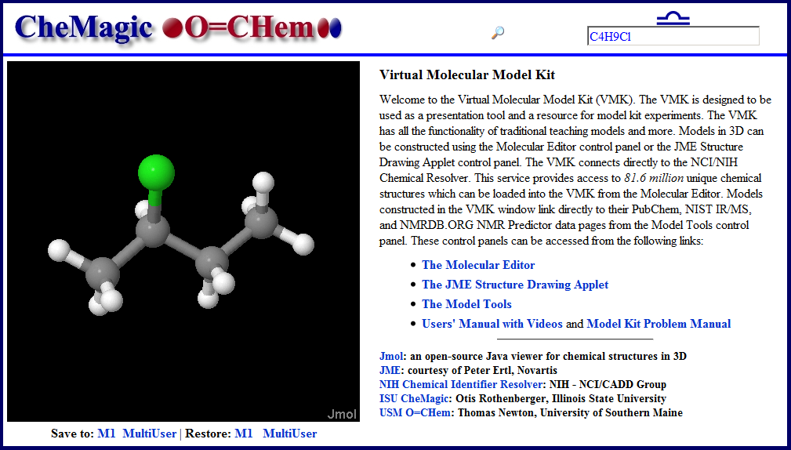
CheMagic O=Chem VMK
Three Main Application Components

Slide 29
CheMagic O=Chem VMK
Three Main Application Components

Slide 30
CheMagic O=Chem VMK
Three Main Application Components

Slide 31
CheMagic O=Chem VMK
Three Main Application Components

Slide 32
CheMagic O=Chem VMK
Three Main Application Components
Database Connectivity

Slide 33
The Molecular Editor
By the beginning of 2010, Jmol’s native scripting language (Jmol Script) had many of the model modification commands required for full model editing. In addition, Bob Hanson had added a Java implementation of Universal Force Field (UFF) minimization. By mid 2010, Jmol had the following abilities:
After the initial construction of a Jmol Script application that tied these abilities into a molecular editor, Bob Hanson incorporated a molecular editor into Jmol’s native Java code – Jmol Model Kit Mode.

Slide 34
The Molecular Editor
By the beginning of 2010, Jmol’s native scripting language (Jmol Script) had many of the model modification commands required for full model editing. In addition, Bob Hanson had added a Java implementation of Universal Force Field (UFF) minimization. By mid 2010, Jmol had the following abilities:
Ability to Change Atom Identity
After the initial construction of a Jmol Script application that tied these abilities into a molecular editor, Bob Hanson incorporated a molecular editor into Jmol’s native Java code – Jmol Model Kit Mode.

Slide 35
The Molecular Editor
By the beginning of 2010, Jmol’s native scripting language (Jmol Script) had many of the model modification commands required for full model editing. In addition, Bob Hanson had added a Java implementation of Universal Force Field (UFF) minimization. By mid 2010, Jmol had the following abilities:
Ability to Change Atom Identity
Ability to Change Bond Order
After the initial construction of a Jmol Script application that tied these abilities into a molecular editor, Bob Hanson incorporated a molecular editor into Jmol’s native Java code – Jmol Model Kit Mode.

Slide 36
The Molecular Editor
By the beginning of 2010, Jmol’s native scripting language (Jmol Script) had many of the model modification commands required for full model editing. In addition, Bob Hanson had added a Java implementation of Universal Force Field (UFF) minimization. By mid 2010, Jmol had the following abilities:
Ability to Change Atom Identity
Ability to Change Bond Order
Ability to Delete Atoms
After the initial construction of a Jmol Script application that tied these abilities into a molecular editor, Bob Hanson incorporated a molecular editor into Jmol’s native Java code – Jmol Model Kit Mode.

Slide 37
The Molecular Editor
By the beginning of 2010, Jmol’s native scripting language (Jmol Script) had many of the model modification commands required for full model editing. In addition, Bob Hanson had added a Java implementation of Universal Force Field (UFF) minimization. By mid 2010, Jmol had the following abilities:
Ability to Change Atom Identity
Ability to Change Bond Order
Ability to Delete Atoms
Ability to Delete Bonds
After the initial construction of a Jmol Script application that tied these abilities into a molecular editor, Bob Hanson incorporated a molecular editor into Jmol’s native Java code – Jmol Model Kit Mode.

Slide 38
The Molecular Editor
By the beginning of 2010, Jmol’s native scripting language (Jmol Script) had many of the model modification commands required for full model editing. In addition, Bob Hanson had added a Java implementation of Universal Force Field (UFF) minimization. By mid 2010, Jmol had the following abilities:
Ability to Change Atom Identity
Ability to Change Bond Order
Ability to Delete Atoms
Ability to Delete Bonds
Ability to Control Scripted Actions by Clicking
After the initial construction of a Jmol Script application that tied these abilities into a molecular editor, Bob Hanson incorporated a molecular editor into Jmol’s native Java code – Jmol Model Kit Mode.

Slide 39
The Molecular Editor
By the beginning of 2010, Jmol’s native scripting language (Jmol Script) had many of the model modification commands required for full model editing. In addition, Bob Hanson had added a Java implementation of Universal Force Field (UFF) minimization. By mid 2010, Jmol had the following abilities:
Ability to Change Atom Identity
Ability to Change Bond Order
Ability to Delete Atoms
Ability to Delete Bonds
Ability to Control Scripted Actions by Clicking
Ability to Minimize UFF of a Model
After the initial construction of a Jmol Script application that tied these abilities into a molecular editor, Bob Hanson incorporated a molecular editor into Jmol’s native Java code – Jmol Model Kit Mode.

Slide 40
The Molecular Editor
By the beginning of 2010, Jmol’s native scripting language (Jmol Script) had many of the model modification commands required for full model editing. In addition, Bob Hanson had added a Java implementation of Universal Force Field (UFF) minimization. By mid 2010, Jmol had the following abilities:
Ability to Change Atom Identity
Ability to Change Bond Order
Ability to Delete Atoms
Ability to Delete Bonds
Ability to Control Scripted Actions by Clicking
Ability to Minimize UFF of a Model
Ability to Save/Restore Model State
After the initial construction of a Jmol Script application that tied these abilities into a molecular editor, Bob Hanson incorporated a molecular editor into Jmol’s native Java code – Jmol Model Kit Mode.

Slide 41
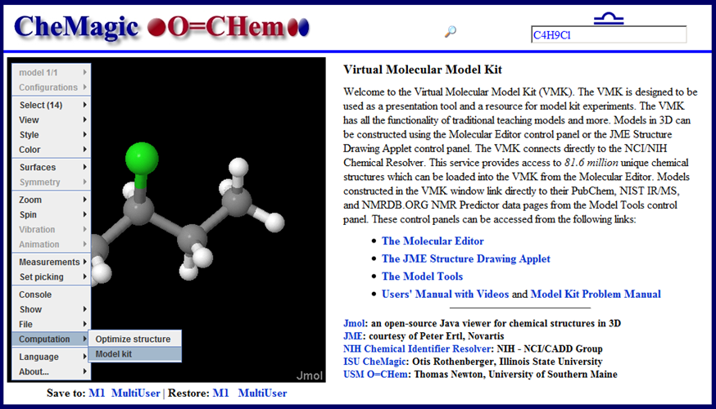
Jmol Model Kit Mode

Slide 42
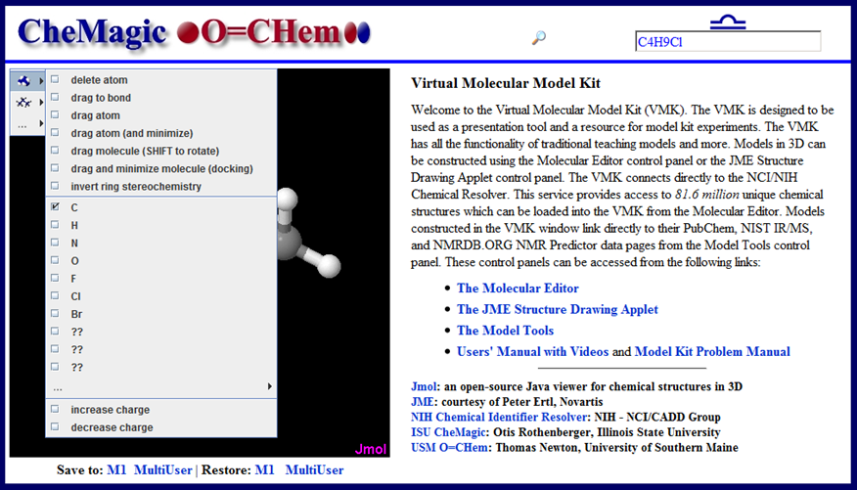
Jmol Model Kit Mode

Slide 43
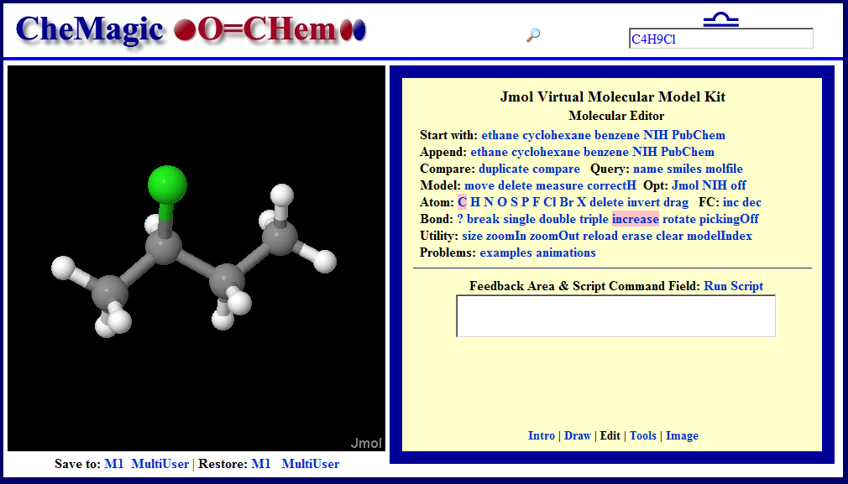
The CheMagic VMK Edit Screen
A Jmol Model Kit Mode Application

Slide 44
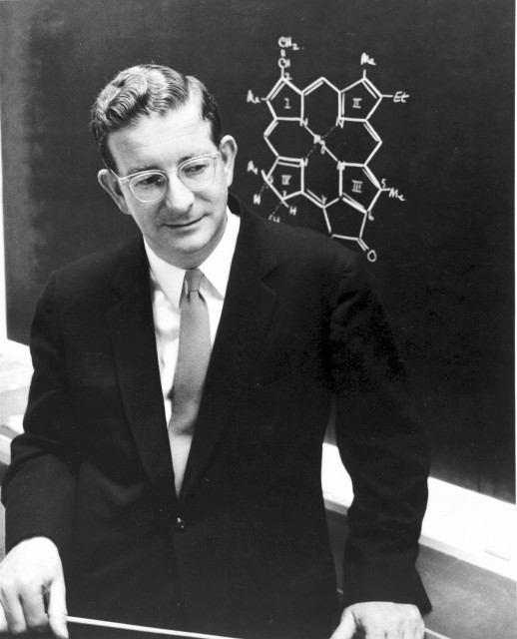
Model Editor Examples
The Master Molecular Editor
Harvard University Archives
http://chemagic.com/web_molecules/

Slide 45
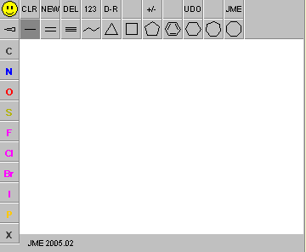

The JME Molecular Drawing Editor
JME Molecular Drawing Editor is a Java applet that can be used two draw 2D structural formulas. The Editor can generate SMILES, 2D molfiles, and JME files from these structural formulas. The applet has been developed by Peter Ertl at Comenius University Bratislava and later enhanced at Ciba-Geigy Basel.
JME Editor: Information Flow
Human
SMILES
JME File
JME File
Molfile
Molfile

Slide 46
Jmol Connects to JME
The development of a 2D to 3D connection of JME to Jmol was coincident with the development of the Jmol Model Kit Mode. The connection development was the logical outcome of two Jmol features:
Ability to Read and Render JME Files
Ability to Make a 2D to 3D Transition with
Universal Force Field (UFF) Minimization
“The JME reader had been there for a long time but hadn't been worked on for ages. Miguel added that in Sept. of 2003.” – Bob Hanson, Current Jmol Primary Developer
The Jmol Users Group dialog that led to this connection is an interesting study in how the Jmol open source project works…

Slide 47
Jmol Connects to JME
A Typical Jmol Users Conversation
“Bob, The JME string might be worth a try. While the information is still 2D only, we have found that you can give UFF minimization good starts and bad starts based on the original 2D drawing.” – Otis, Jmol User
“Otis, Are you transferring the JME structure as a Smiles string or as a JME string? The latter has more information in it.” – William Reusch, Jmol User
“Otis, if you think it would be valuable, we could look into reading the stereochemistry of bonds and at least shifting a whole branch up or down an angstrom in the Z coordinate based on that. Wouldn't be perfect, but it might not be that hard, either .” – Bob Hanson, Current Jmol Primary Developer
“I have it set up on my home server. I'm only working with small molecules, but I haven't had a clunker yet. Wow, I am impressed! ” – Otis, Jmol User
“Isn't that fun? I'll set up a little JME reader for that new.htm page next.” – Bob Hanson, Current Jmol Primary Developer

Slide 48


The Connection Conversation Explained
SMILES
SMILES
C[C@H](CCC)Cl
C[C@@H](CCC)Cl
JME File
JME File
6 5 C 3.92 -5.99 C 5.13 -5.29 C 6.34 -5.99 C 7.56 -5.29 C 8.77 -5.99 Cl 5.13 -3.89 1 2 1 2 3 1 3 4 1 4 5 1 2 6 -1
6 5 C 3.92 -5.99 C 5.13 -5.29 C 6.34 -5.99 C 7.56 -5.29 C 8.77 -5.99 Cl 5.13 -3.89 1 2 1 2 3 1 3 4 1 4 5 1 2 6 -2

Slide 49
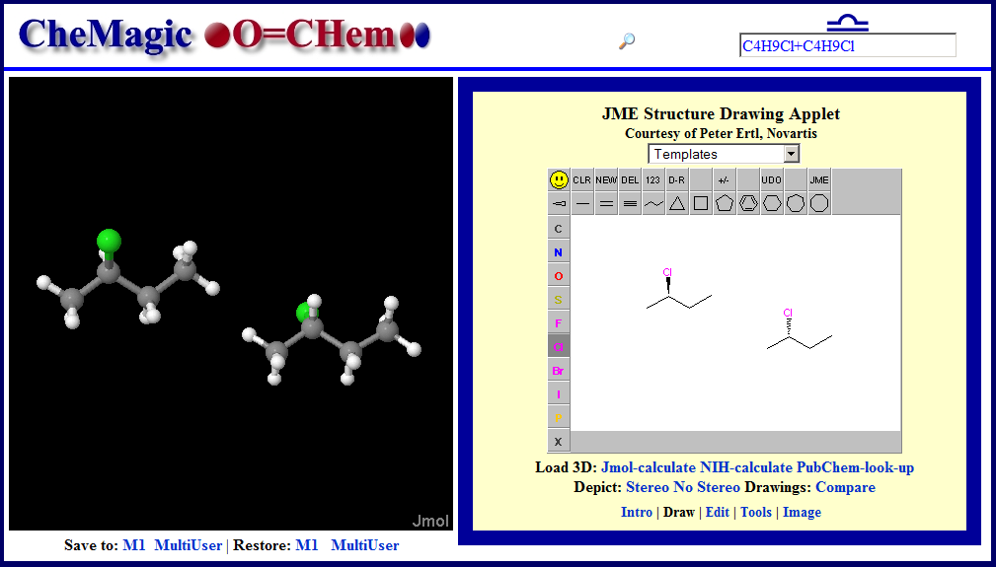
The Connection Implemented

Slide 50
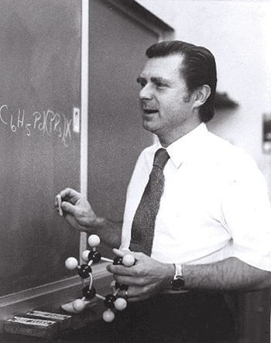
Model Drawing Examples
A Heck of a Model Drawer
University of Delaware Messeger – Vol 18, No 3
http://chemagic.com/web_molecules/

Slide 51
Jmol/JME Information Flow
Molfile
JME File
Many
Others
Human
Molfile
JME File
Human
JME
JME File
Jmol
SMILES
Molfile
JME File
SMILES
Molfile
State

Slide 52
Jmol/JME Information Flow
Molfile
JME File
Many
Others
Human
Molfile
JME File
Human
JME
JME File
Jmol
SMILES
Molfile
JME File
SMILES
Molfile
State
This is a monologue!

Slide 53
Jmol/JME Information Flow
Molfile
JME File
Many
Others
Human
Molfile
JME File
Human
JME
JME File
Jmol
SMILES
Molfile
JME File
SMILES
Molfile
State
Hello World! Is anybody out there?

Slide 54
Hello World! Is anybody out there?
The answer to this question is, “Oh my yes, but you are going to have to speak more languages.”
R-2-chlorobutane
C[C@@H](Cl)CC
BSPCSKHALVHRSR-SCSAIBSYSA-N
23616278
1S/C4H9Cl/c1-3-4(2)5/h4H,3H2,1-2H3/t4-/m1/s1
53178-20-4 78-86-4 68990-22-7
(2R)-2-chlorobutane

Slide 55
CAS Numbers for Ethanol
68475-56-9
71329-38-9
121182-78-3
8000-16-6
71076-86-3
64-17-5
8024-45-1

Slide 56
Important Notes about Jmol SMILES
{*}.find(“SMILES”)
{*}.find(“SMILES”,smiles1)
compare({model1}, {model2}, “ISOMER”)
compare(smi1, smi2, “ISOMER”)

Slide 57
Important Notes about Jmol SMILES
{*}.find(“SMILES”)
Determine the SMILES of the model.
{*}.find(“SMILES”,smiles1)
compare({model1}, {model2}, “ISOMER”)
compare(smi1, smi2, “ISOMER”)

Slide 58
Important Notes about Jmol SMILES
{*}.find(“SMILES”)
Determine the SMILES of the model.
{*}.find(“SMILES”,smiles1)
Is the model SMILES equivalent to smiles1?
compare({model1}, {model2}, “ISOMER”)
compare(smi1, smi2, “ISOMER”)

Slide 59
Important Notes about Jmol SMILES
{*}.find(“SMILES”)
Determine the SMILES of the model.
{*}.find(“SMILES”,smiles1)
Is the model SMILES equivalent to smiles1?
compare({model1}, {model2}, “ISOMER”)
Are model1 and model2 identical, enantiomeric, diasteriomeric, or different?
compare(smi1, smi2, “ISOMER”)

Slide 60
Important Notes about Jmol SMILES
{*}.find(“SMILES”)
Determine the SMILES of the model.
{*}.find(“SMILES”,smiles1)
Is the model SMILES equivalent to smiles1?
compare({model1}, {model2}, “ISOMER”)
Are model1 and model2 identical, enantiomeric, diasteriomeric, or different?
compare(smi1, smi2, “ISOMER”)
Are smiles1 and smiles2 identical, enantiomeric, diasteriomeric, or different?

Slide 61
Chemical Identifier Resolver
NIH: NCI/CADD Group Web Resource
“representation”
“identifier”
/smiles
/names, /iupac_name
/cas
/inchi, /stdinchi
/inchikey, /stdinchikey
/ficts, /ficus, /uuuuu
/image
/file, /sdf
/mw, /monoisotopic_mass
/formula
/twirl, /3d (Just for Fun)
/urls (Possibilities)
chemical names
CAS numbers
*SMILES strings
IUPAC InChI/InChIKeys
NCI/CADD Identifiers
CACTVS HASHISY
NSC number
*molfile
Resolver
Markus Sitzmann
http://cactus.nci.nih.gov/chemcial/structure
* Spoken by Jmol

Slide 62
Chemical Identifier Resolver
NIH: NCI/CADD Group Web Resource
identifier
representation
http request
http response
identifier is a
full structure
representation
(e.g. SMILES, InChI)
calculation of the
requested structure
representation
detection of
the identifier
type
e.g. InChI, GIF image
structure
identifier is a
hashed structure
representation
(e.g. InChIKey),
chemical name
etc.
CACTVS
e.g. CAS number,
chemical name
database lookup

Slide 63
Because Someone is Going to Ask
When SDF is computed, what mechanics approach is used?
“For that, CACTVS (http://www.xemistry.com) is used. CACTVS parses the original SMILES string, creates an internal structure representation (called "ens" for “ensemble”). From this representation a lot of properties can be calculated including a long list of file format representation including SDF.”
Markus Sitzmann

Slide 64
Information Flow: Jmol’s Social Network
JME
JME File
Jmol
*SMILES
Wikipedia
*NmCaIn
JME File
SMILES
Molfile
*NmCaIn
Molfile
Molfie
SMILES
NIH Resolver
Molfile
InChiKey
InChiKey
SMILES
NIST Webbook
NMRDB.ORG
PubChem
NmCaIn = Name, CAS, InChiKey
*Human Entered Query

Slide 65
Information Flow: Jmol’s Social Network
JME
JME File
Jmol
*SMILES
Wikipedia
*NmCaIn
JME File
SMILES
Molfile
*NmCaIn
Molfile
Molfie
SMILES
NIH Resolver
Molfile
InChiKey
InChiKey
SMILES
NIST Webbook
NMRDB.ORG
PubChem
NmCaIn = Name, CAS, InChiKey
*Human Entered Query

Slide 66
Information Flow: Jmol’s Social Network
JME
JME File
Jmol
*SMILES
Wikipedia
*NmCaIn
http://chemistry.illinoisstate.edu/osrothen/web_molecules/nih.aspx?smi2sdf=CCC
?inchi2cid= TO/FROM PUBCHEM ?smi2name= TO/FROM RESOLVER
?smi2smi= TO/FROM RESOLVER ?smi2sdf= TO/FROM RESOLVER
?smi2names= TO/FROM RESOLVER ?smi2inchi= TO/FROM RESOLVER
?smi2jme= TO/FROM RESOLVER ?cid2sdf= TO/FROM PUBCHEM
?name2cid= TO/FROM PUBCHEM ?sdf2smi= TO/FROM PUBCHEM
NIST Webbook
NMRDB.ORG
PubChem
NmCaIn = Name, CAS, InChiKey
*Human Entered Query

Slide 67
Information Flow: Jmol’s Social Network
JME
JME File
Jmol
*SMILES
Wikipedia
*NmCaIn
http://chemistry.illinoisstate.edu/osrothen/web_molecules/nih.aspx?smi2sdf=CCC
NIST Webbook
NMRDB.ORG
PubChem
NmCaIn = Name, CAS, InChiKey
*Human Entered Query

Slide 68
Information Flow: Jmol’s Social Network
JME
JME File
Jmol
*SMILES
Wikipedia
*NmCaIn
Bradenton, FL, USA
Jmol
State
Jmol
State
Jmol
Jmol
State
Jmol
London, UK
Lima, Peru
http://chemistry.illinoisstate.edu/osrothen/web_molecules/nih.aspx?smi2sdf=CCC
NIST Webbook
NMRDB.ORG
PubChem
NmCaIn = Name, CAS, InChiKey
*Human Entered Query

Slide 69
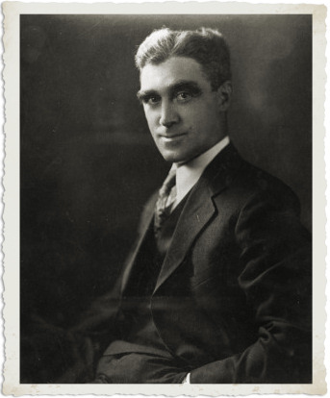
Social Network Examples
The Network Professor
Wayne State University
http://chemagic.com/web_molecules/

